Slide 1
Remedial Reading Kit: Decode Workshop
Welcome Teachers!
Notes:
Put books from decode system out on tables

Slide 2
Upon arrival Please Sign In

Slide 3
Name the greatest Challenge
What is the greatest challenge you face when teaching reading?
We want to address your challenges in today’s workshop.
Notes:
Possible answers you will get: Decoding and syllables, Students don’t understand, resistant children, how to make it fun, suitable passages, sight words, lack of resources, peer pressure. When opening like this you can point out throughout the training where and how the kit can help the teachers face the challenges they have. We used https://answergarden.ch/ to display the answers if you have wifi this is a fun way to share the info. If you don’t then use the powerpoint slide and type the answers in so they show up on the slide

Slide 4
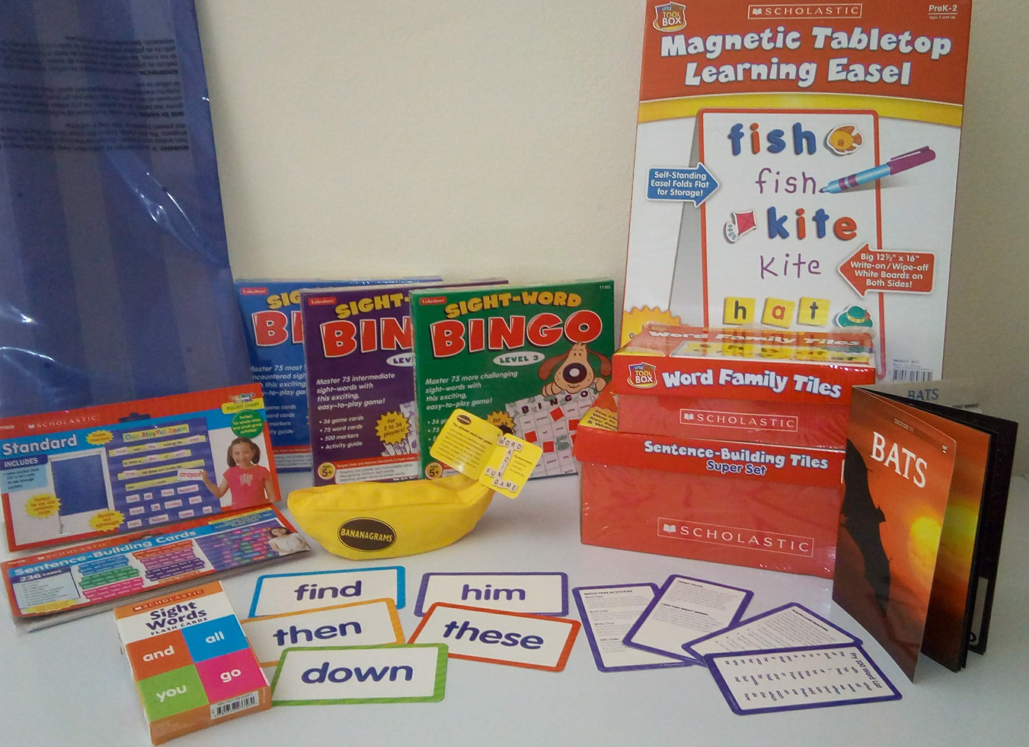
What’s In The Kit?
Pocket Chart & Sentence-Building Cards
Sight Word Flash Cards and Bingo
Bananagrams – Word building
Magnetic Tabletop Learning Easel
Word family magnet tiles
Sentence building magnet tiles
The Decode System
Notes:
Each of these items comes with pre-written activities you can choose to enhance what you are teaching your students. Spelling, Rhyming, Writing, Describing.

Slide 5

the DECODE System
3 copies of each leveled book for guided reading groups
Teacher’s Manual with lesson plans, comprehension questions, activity ideas, and reproducible worksheets that correspond with each book
Notes:
Show books and show manual

Slide 6

Why use the Decode system?
16-page books with mature, engaging content written at beginning reader levels that teach phonics and comprehension skills.
Older students are at a different cognitive level than younger students. Teaching reading to young adults should be a different process than that used to teach young children.
Many secondary students feel embarrassed or bored with the content if they have to practice reading with materials that are written for younger readers, crushing both their interest and motivation.
Notes:
The decode system is geared towards your students age.

Slide 7

Decode System
Let’s take the overwhelming task of teaching reading and break it down to easy manageable tasks using the remedial kit.
Notes:
Place the decode book sets so that all teachers have access to them. Have them pull out the Bats book copies

Slide 8

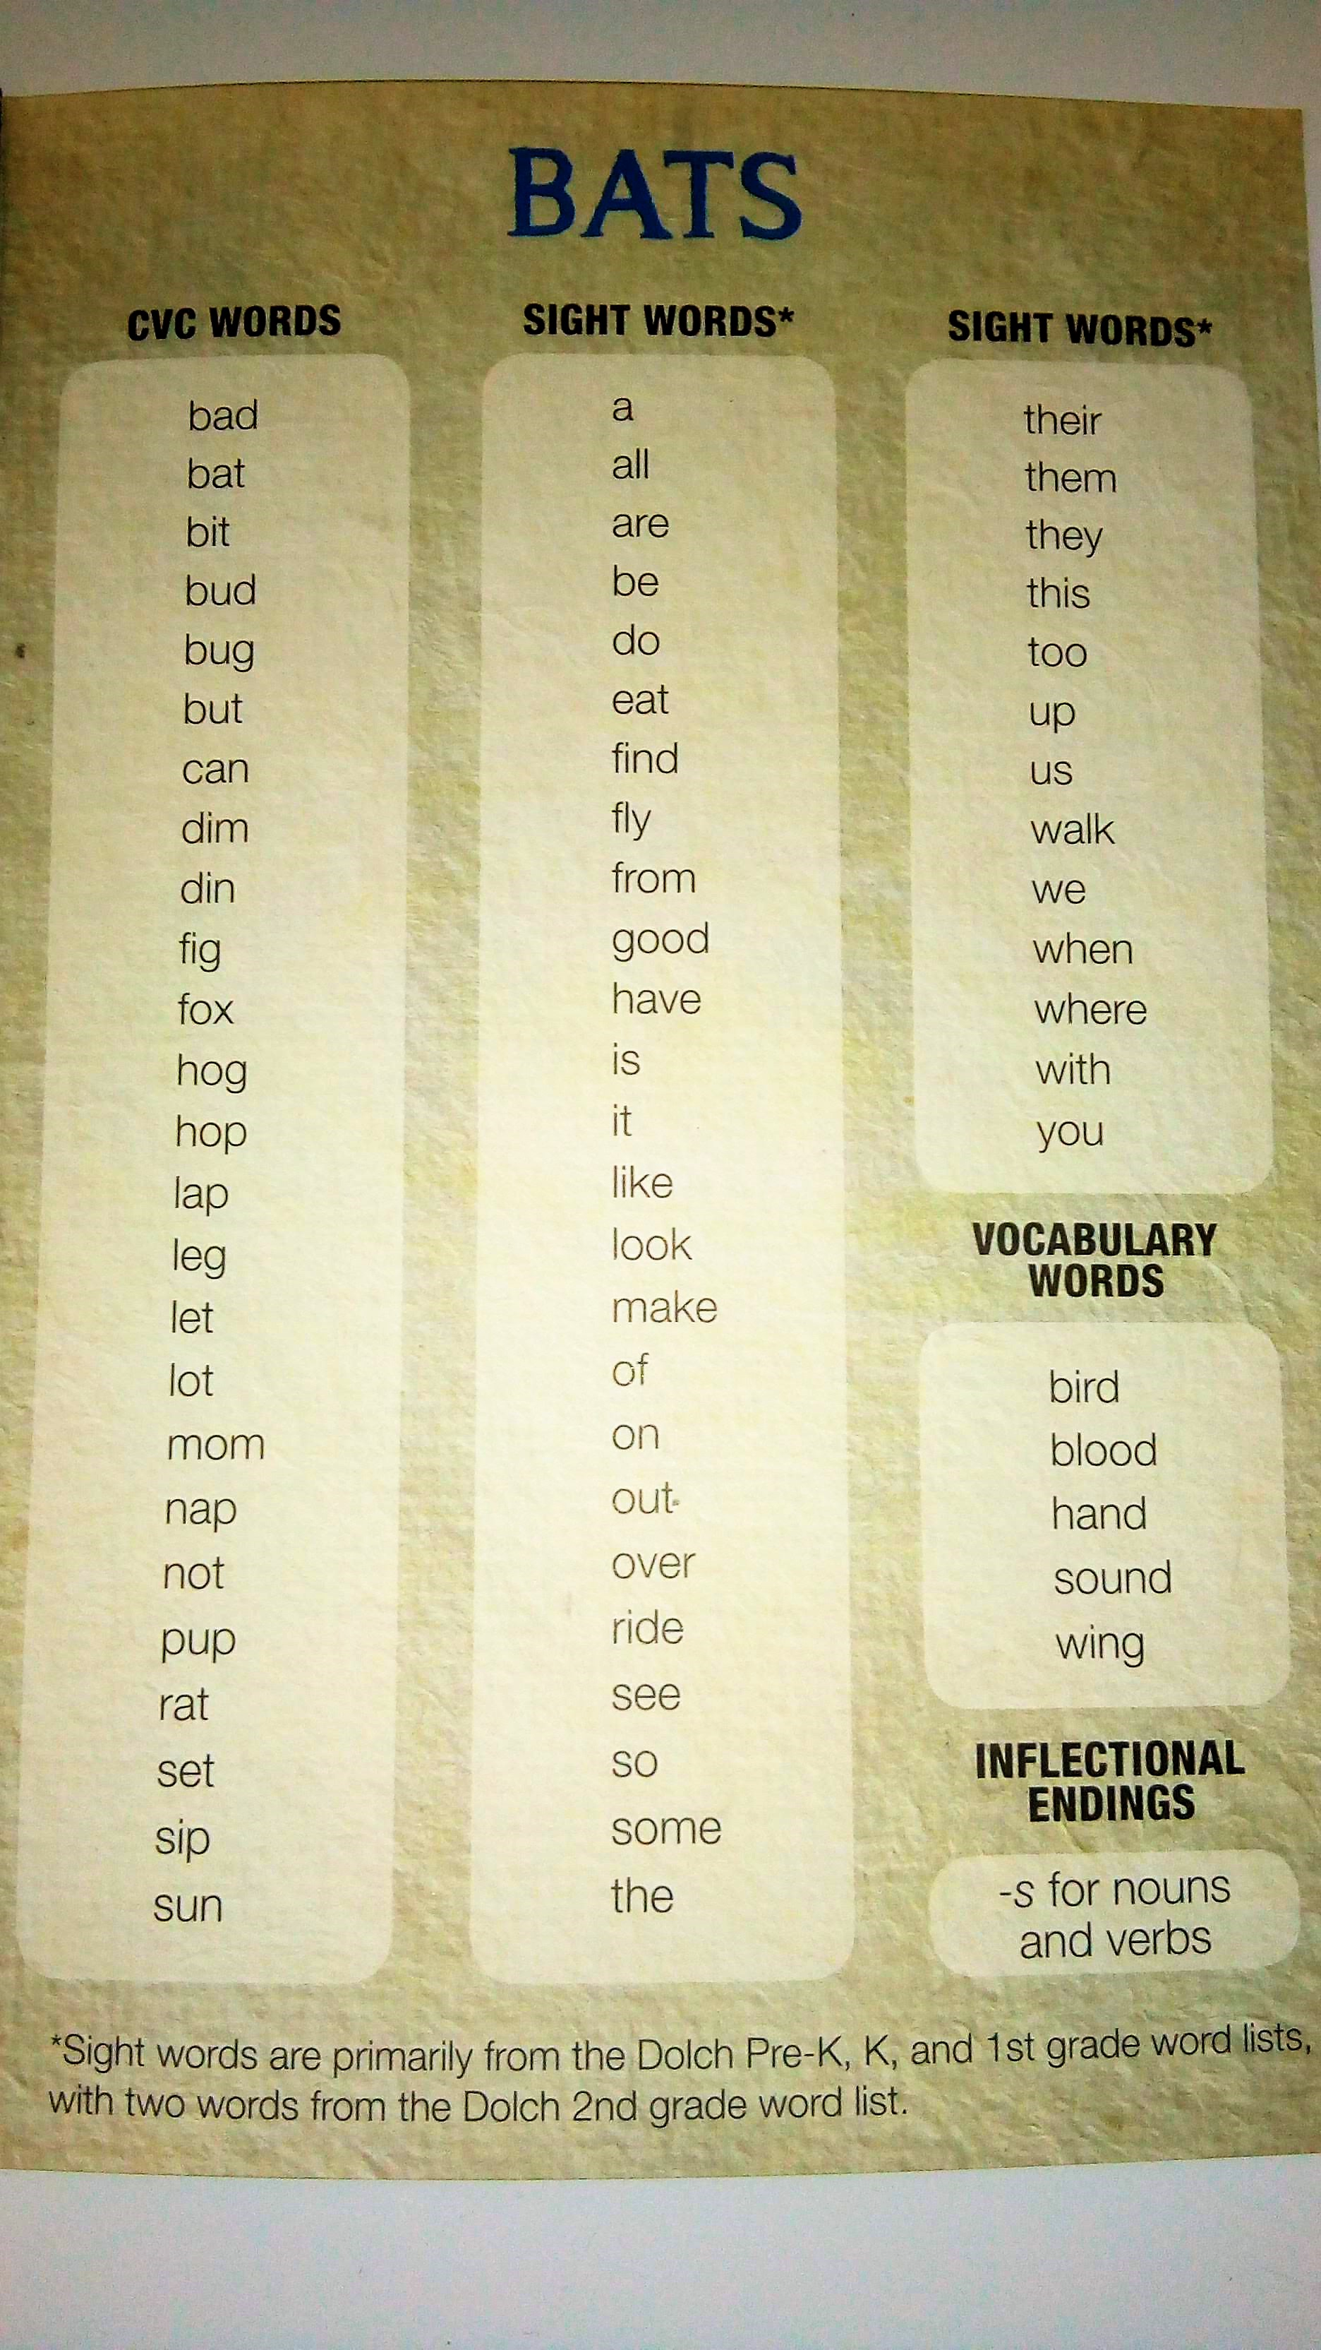
Book Overview: Phonics Skills What am I teaching?
Initial Single Consonants (b)
Final Single Consonants (t)
Short Vowel Sounds (a)
Consonant- Vowel- Consonant (CVC) Words (bad, bat, bit, bud, bug, but)
Inflectional Ending –s: Plural –s (bats)
Inflectional Ending – s: Third-Person
Singular –s (The Mix: Dex wants, Dex puts)
Notes:
Use Bats book to help teachers learn what each phonics skill means per say. First point out that in the back of each book is a list of phonics words labeled as CVC words, inflectional endings etc……You may need to go over what inflectional endings were in further depth and gave more examples than what was on the slide.
This is meant to help teachers feel confident in the program and what their students will be learning inadvertently as they progress through the books.

Slide 9
Phonics Skills Chart
Book | Lesson Page # | Initial Single Consonants | Final Single Consonants | Short Vowel Sounds (a, e, I, o, u) | Consonant-Vowel- (CVC) Word | Inflectional Ending –s: Plural - s | Inflectional Ending –s: Third-Person Singular -s
Bog Man | 26 | b and m | g and n | a and o | X |  | X
Fads | 31 | f | d | a | X | X
Hip Hop | 36 | h | p | i and o | X
The Lab | 41 | l | b | a | X
Mad | 46 | m | d | a and u | X
The Mix | 51 | d and m | x | e and i | X |  | X
Bats (NF) | 56 | b | t | a | X | X
Fit (NF) | 61 | b, f, g, j, and r | g, n, and t | a, e, i, o, and u | X
Notes:
Page 12 Go through Bats book and discuss phonics skills chart
Use The Mix book to show third person singular s’s
Discuss the other phonics skills on other charts

Slide 10
Book overview Chart
Book | Fiction/ Nonfiction | Theme | Readability Level | Lexile Level | Word Count
Bog Man | F | a man who becomes a vengeful monster | 0.5 | BR/0 | 152
Fads | F | fads in the 1980s | 0.5 | 70L | 152
Hip Hop | F | celebrating urban music | 0.5 | BR/0 | 152
The Lab | F | escaping from alien experimenters | 0.3 | BR/0 | 155
Mad | F | babysitting a trouble maker | 0.5 | BR/0 | 147
The Mix | F | becoming a DJ | 0.5 | BR/0 | 135
Bats | NF | exploring bats | 0.5 | BR/0 | 139
Fit | NF | staying physically fit | 0.3 | BR/0 | 151
Notes:
Page 14 Fiction versus Nonfiction
Connection to curriculum content and personal connection to the content

Slide 11
Book Overview: THeme
Do you see any themes in the charts that coincide with what students are learning in their classes?
Do you see any themes you know your students will enjoy reading about?
Do you see any themes that you can relate to yourself?
Notes:
Have teachers turn to pages 14-15 - Give them one or two examples: The Mess is about the environment. Have them pull the books to peruse and make connections to things students might be learning in the classroom. Group them and have them share their answers.
If you don’t see connections, don’t worry or think these are not relavant. They are for teaching reading, but if content is there it is an added bonus

Slide 12
Book overview Chart
Book | Fiction/ Nonfiction | Theme | Readability Level | Lexile Level | Word Count
Bog Man | F | a man who becomes a vengeful monster | 0.5 | BR/0 | 152
Fads | F | fads in the 1980s | 0.5 | 70L | 152
Hip Hop | F | celebrating urban music | 0.5 | BR/0 | 152
The Lab | F | escaping from alien experimenters | 0.3 | BR/0 | 155
Mad | F | babysitting a trouble maker | 0.5 | BR/0 | 147
The Mix | F | becoming a DJ | 0.5 | BR/0 | 135
Bats | NF | exploring bats | 0.5 | BR/0 | 139
Fit | NF | staying physically fit | 0.3 | BR/0 | 151
Notes:
Page 14 Fiction versus Nonfiction
Connection to curriculum content and personal connection to the content
Readability level – figuring out what reading level your students are on
Lexile Level

Slide 13
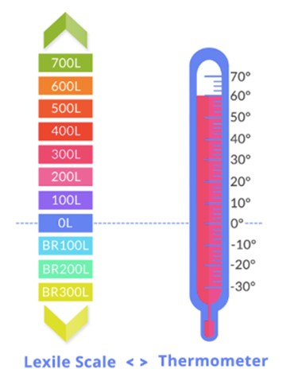
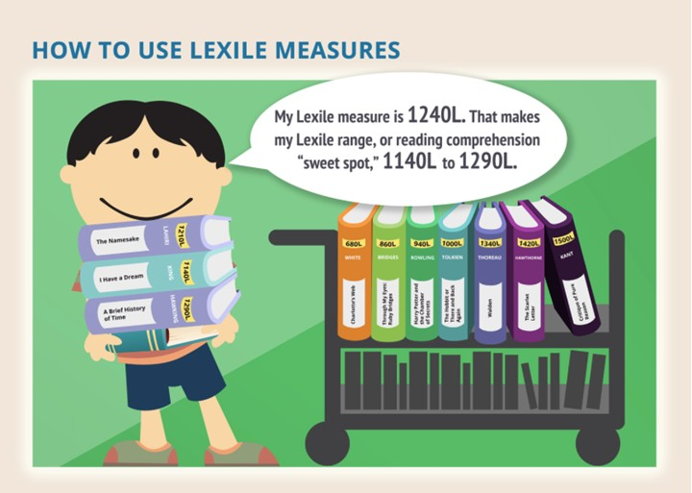
Lexile Reading levels
Notes:
As your students progress with reading their lexile measure will go up.

Slide 14
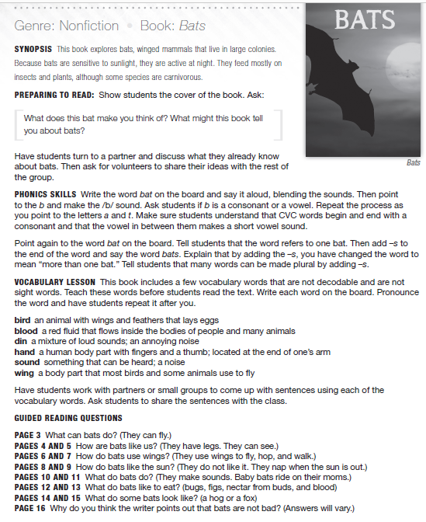
Lesson Plans
Synopsis
Preparing to Read
Phonics Skills
Vocabulary Lesson
Guided Reading Questions
After Reading
Notes:
In each lesson plan you will find……list them do not describe here

Slide 15
Synopsis
This book explores bats, winged mammals that live in large colonies. Because bats are sensitive to sunlight, they are active at night. They feed mostly on insects and plants, although some species are carnivorous.
Notes:
We are going to take a look at a lesson plan together. Turn to page 56. You may want to mark this in a manual you have and show them where to go.

Slide 16
What is Guided REading
The steps for a guided reading lesson are:
Before reading: Set the purpose for reading, introduce vocabulary, make predictions, talk about the strategies good readers use.
During reading: Guide students as they read, provide wait time, give prompts or clues as needed by individual students, such as "Try that again. Does that make sense? Look at how the word begins."
After reading: Strengthen comprehension skills and provide praise for strategies used by students during the reading.
Notes:
Each lesson plan in the decode system provides detailed information on each step of the guided reading process.

Slide 17
Preparing to Read
Preview the text
Phonics skills
Vocabulary development
Notes:
List the items that you will go over in more detail in the following slides. Here just list them as an overview of items that the lesson plans suggest you do before you read the book.

Slide 18
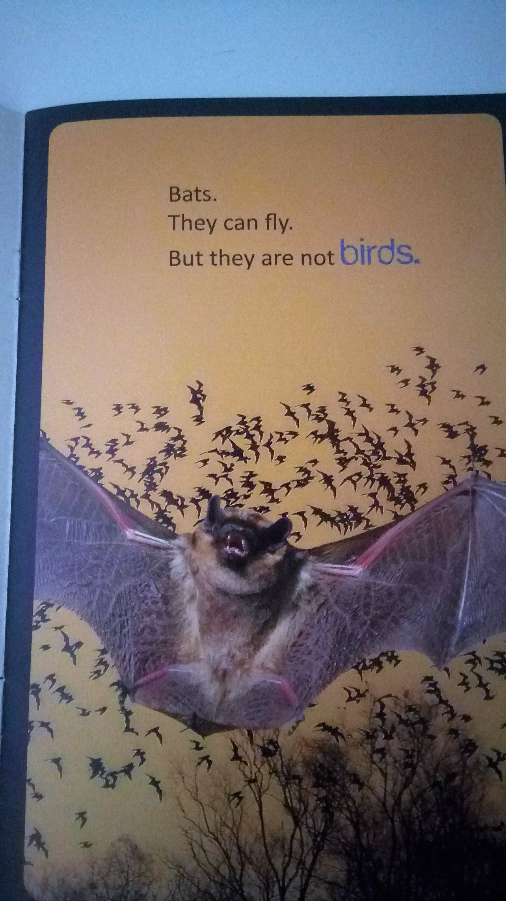
Preview the Text: Any Book
Before students read the text, help them activate prior knowledge and engage prediction skills by:
Looking at the book’s cover for clues to the book’s topic and tone.
Preview Text: Skimming the text’s words and images to get a sense of its content. Asking questions (What is this book about? What will I learn from reading it? What is going on here?).
Notes:
Refer to Page 19 in the teachers manual and the bats book. Model the beginnings of a picture walk. What is it and how do I execute it?
What do you think this book is about based on the picture on the cover?
Cover the text of the first page showing only the picture.
"What is going on here?" "What animal is this?"

Slide 19

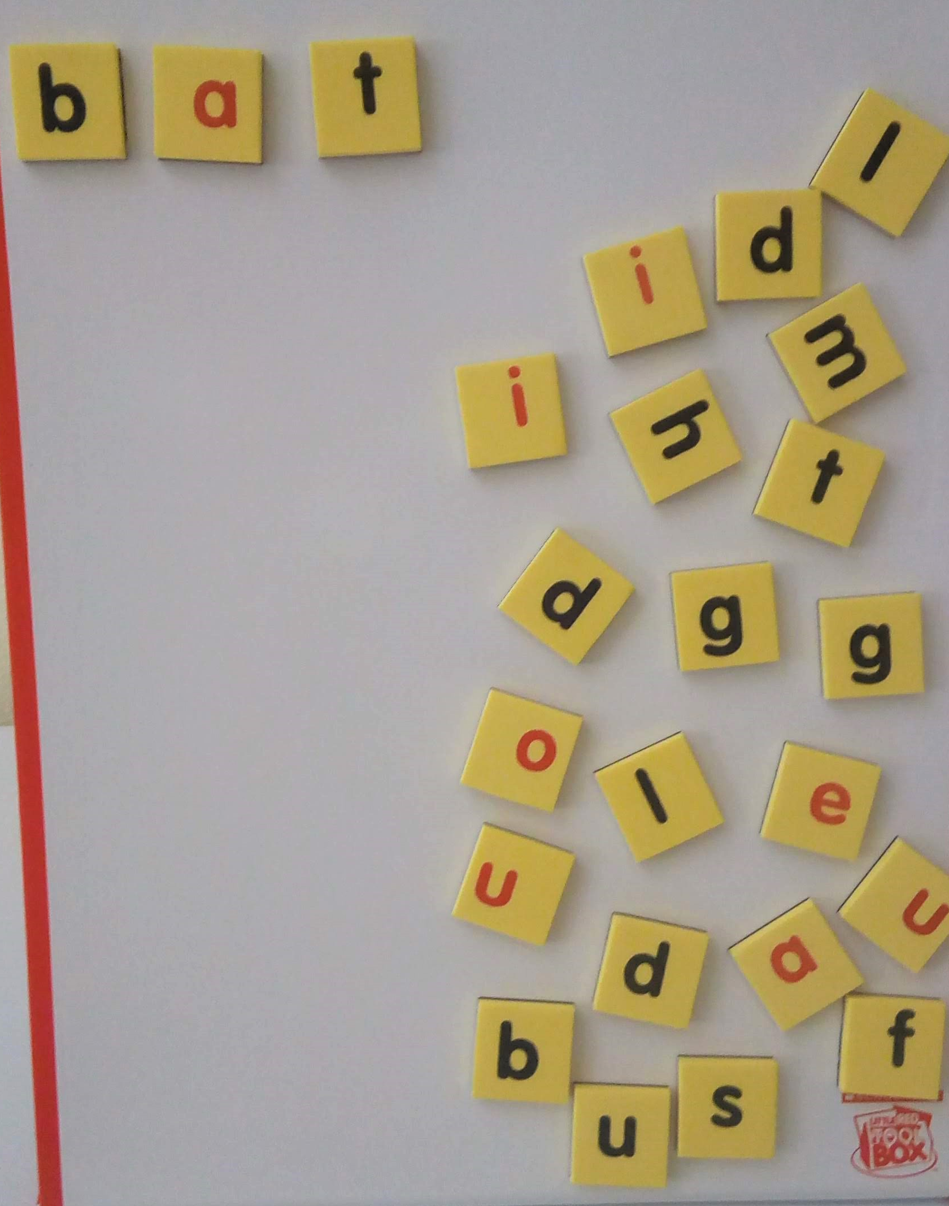
Phonics Skills:
Write the word bat on the board. Say it aloud, blending the sounds. Then point to the b and
make the /b/ sound.
Ask students if b is a consonant or a vowel. Repeat the process as you point to the
letters a and t.
Make sure students understand that CVC words begin and end with a consonant.
Notes:
Magnetic board with a selection of word building tiles mixed that create words for the CVC list. Do together as a group.
Each table gets a bananagrams letter tiles and the book Bats. They will have 1 minute to put together as many CVC words from the list at the back of the book together.

Slide 20
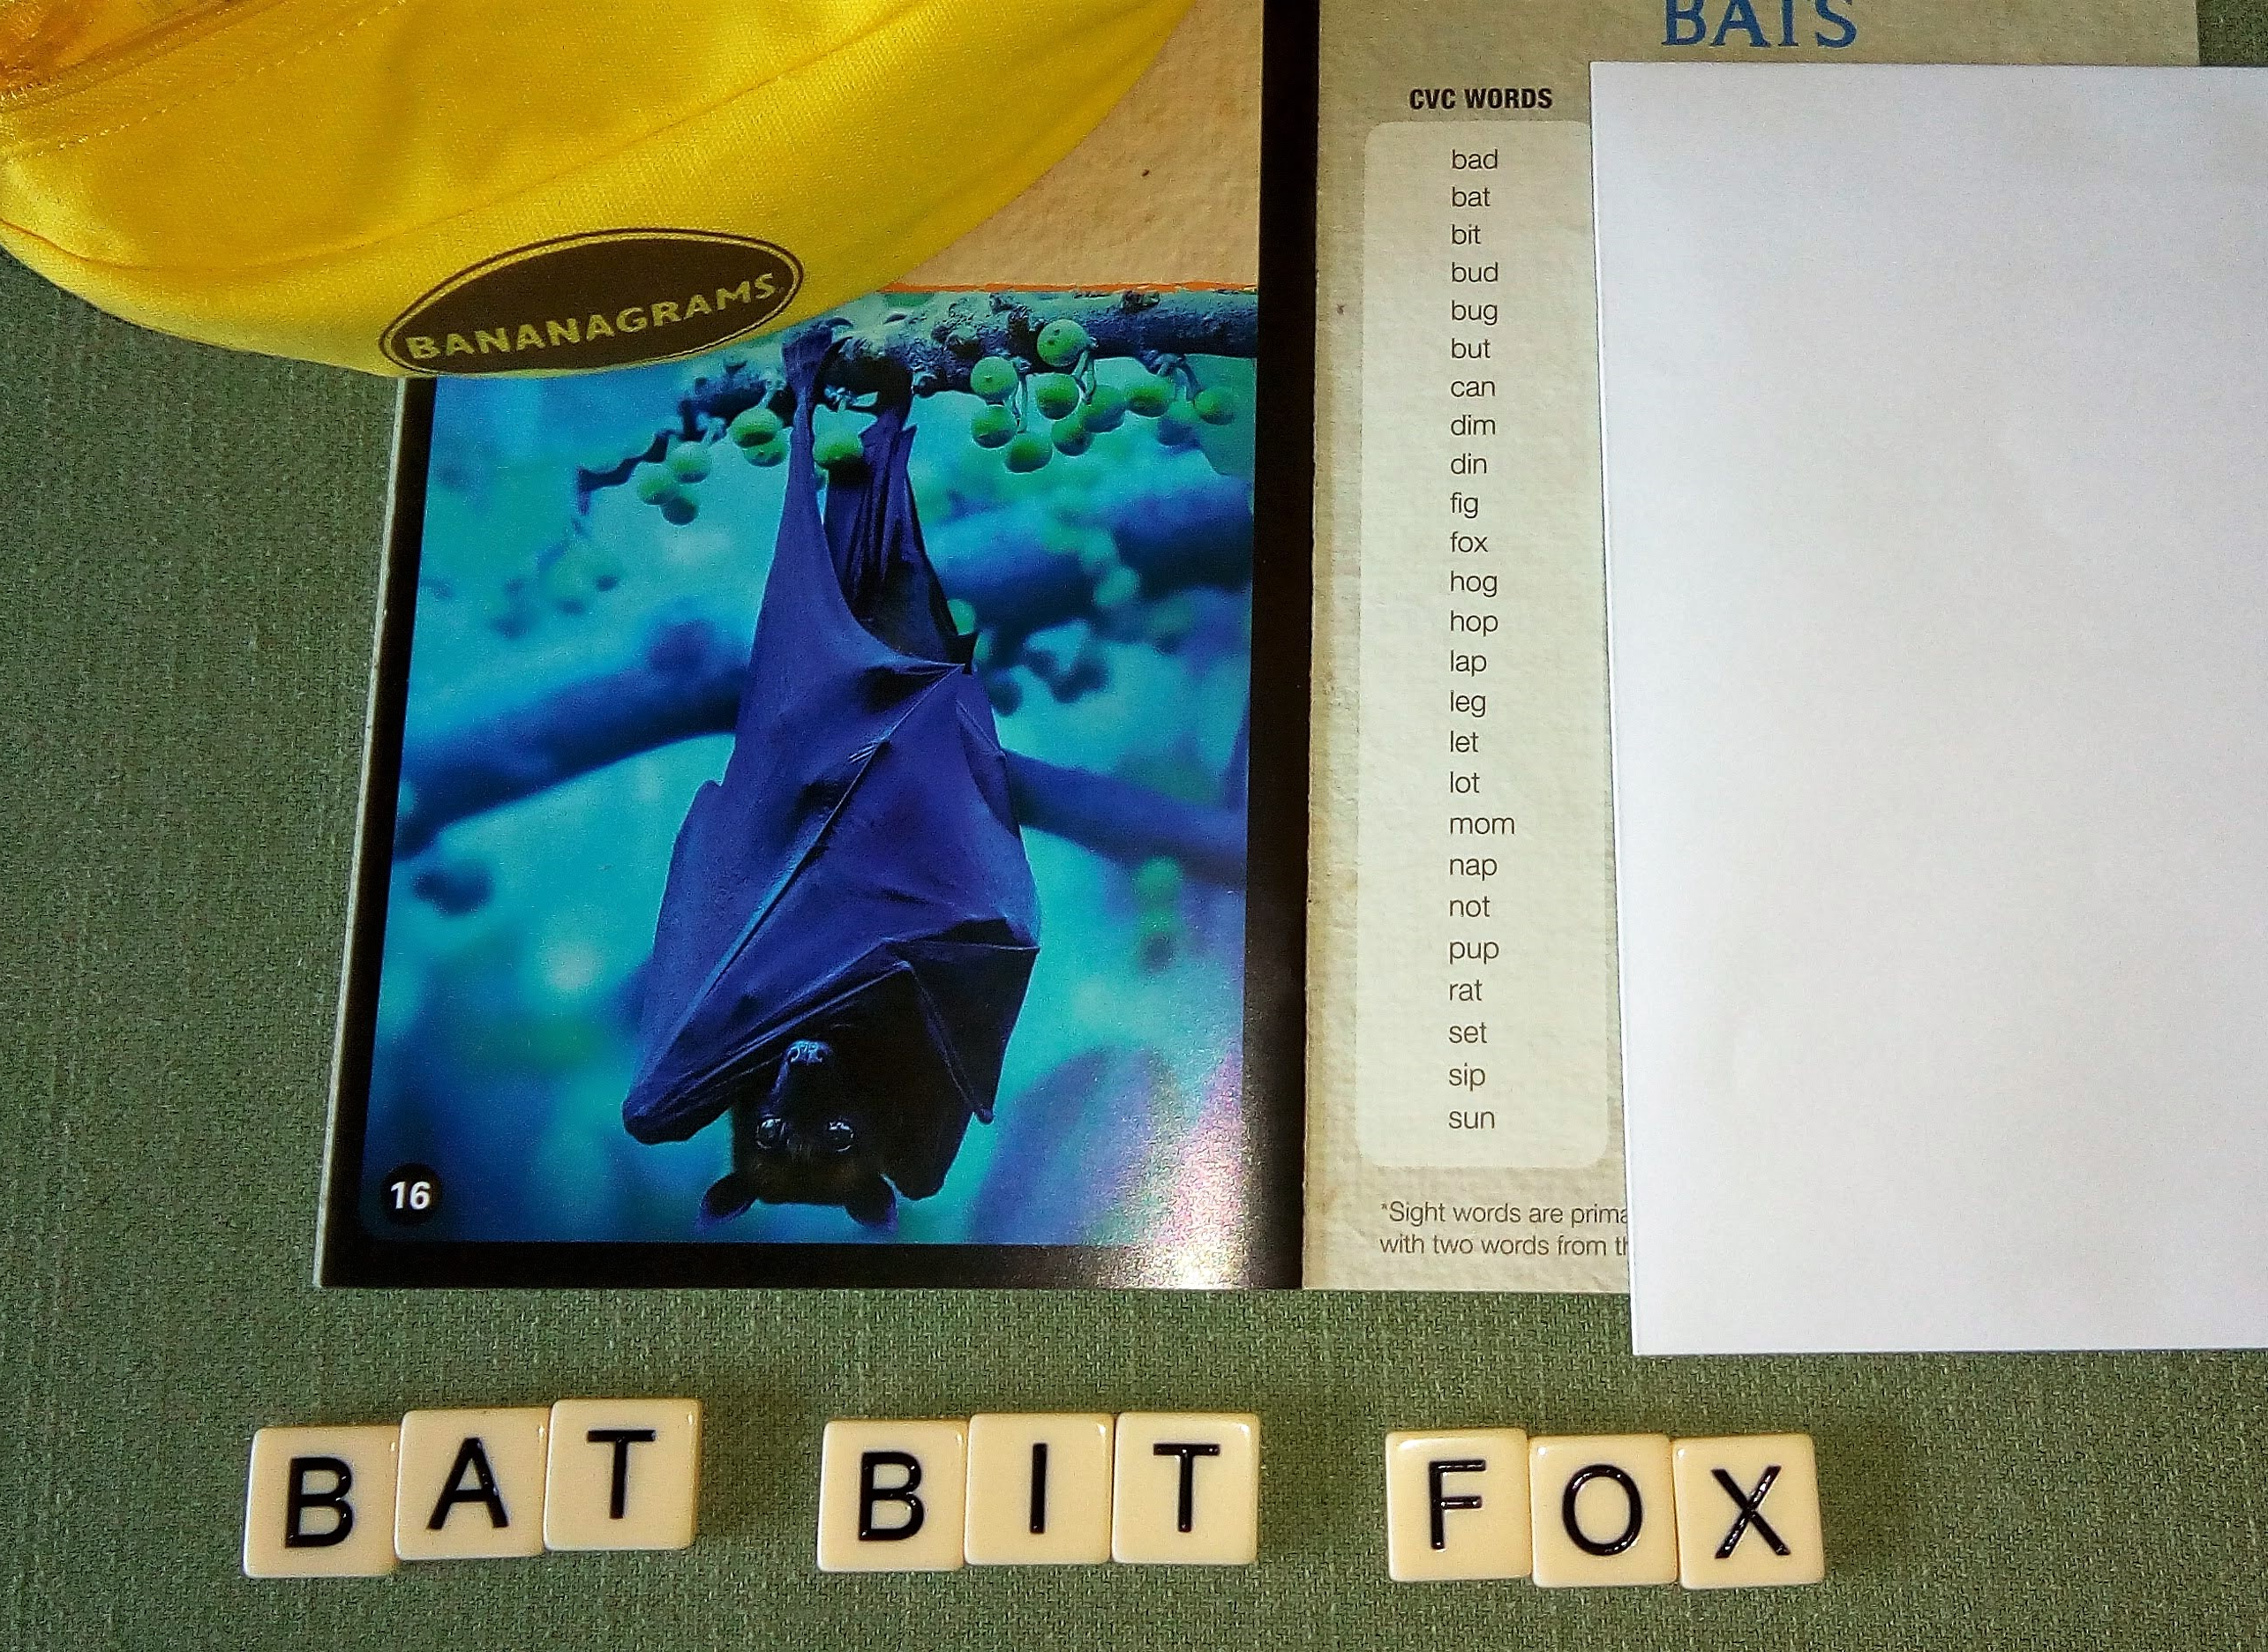
Other Phonics Strategies: Other Books and resources from the Remedial Reading Kit
Letter Hunt
Practice using the book you are working with
Word Lists
Word wall for CVC words
Word Descriptions
Guess my word
Notes:
Have each table pick up their bat books. Have them hunt for the letter b on page 1. How many letter b’s do you see on page 1?

Slide 21
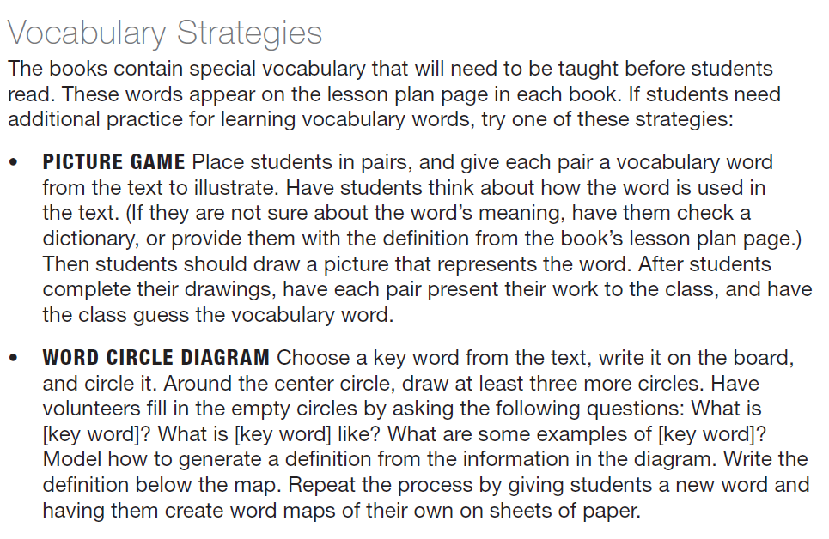
Vocabulary Lesson:
Remember to always teach the vocabulary words that are not decodable and are not sight words before your students read the texts.
Vocabulary words are listed for you in the back of each book.
Use the vocabulary strategies
in the manual
Picture Game
Word Circle Diagram
Notes:
Go to page 20 for picture game description and word circle diagram.

Slide 22
Circle Diagram
feathers
wings
bird
fly
Notes:
What makes up a bird? As humans we have legs, arms. What do birds have?
How do birds travel?

Slide 23
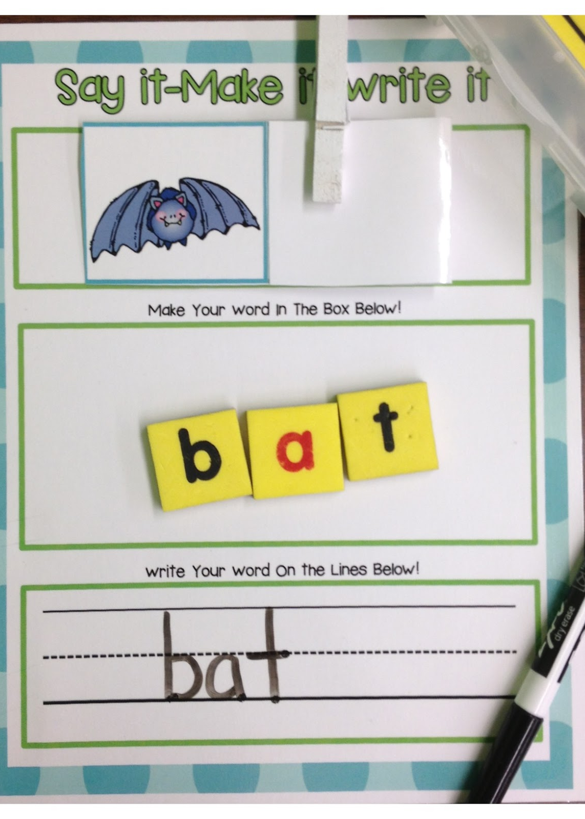
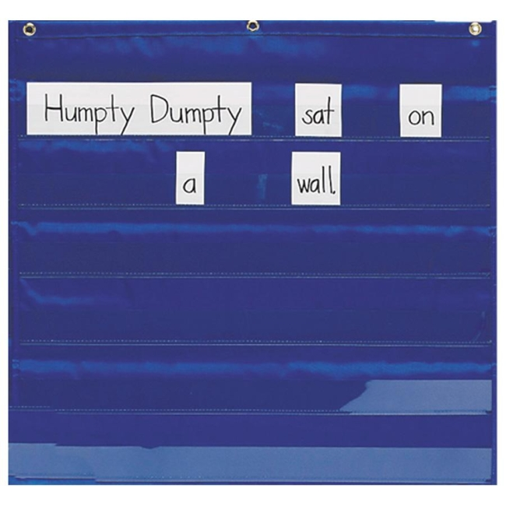
Vocabulary Activities
You can also use resources from the Remedial Kit to teach vocabulary
Magnet board (vocabulary words)
Sentence building pieces
(making sentences with vocabulary words)
Note: You may need to add words to your collection for the sentence making.

Slide 24

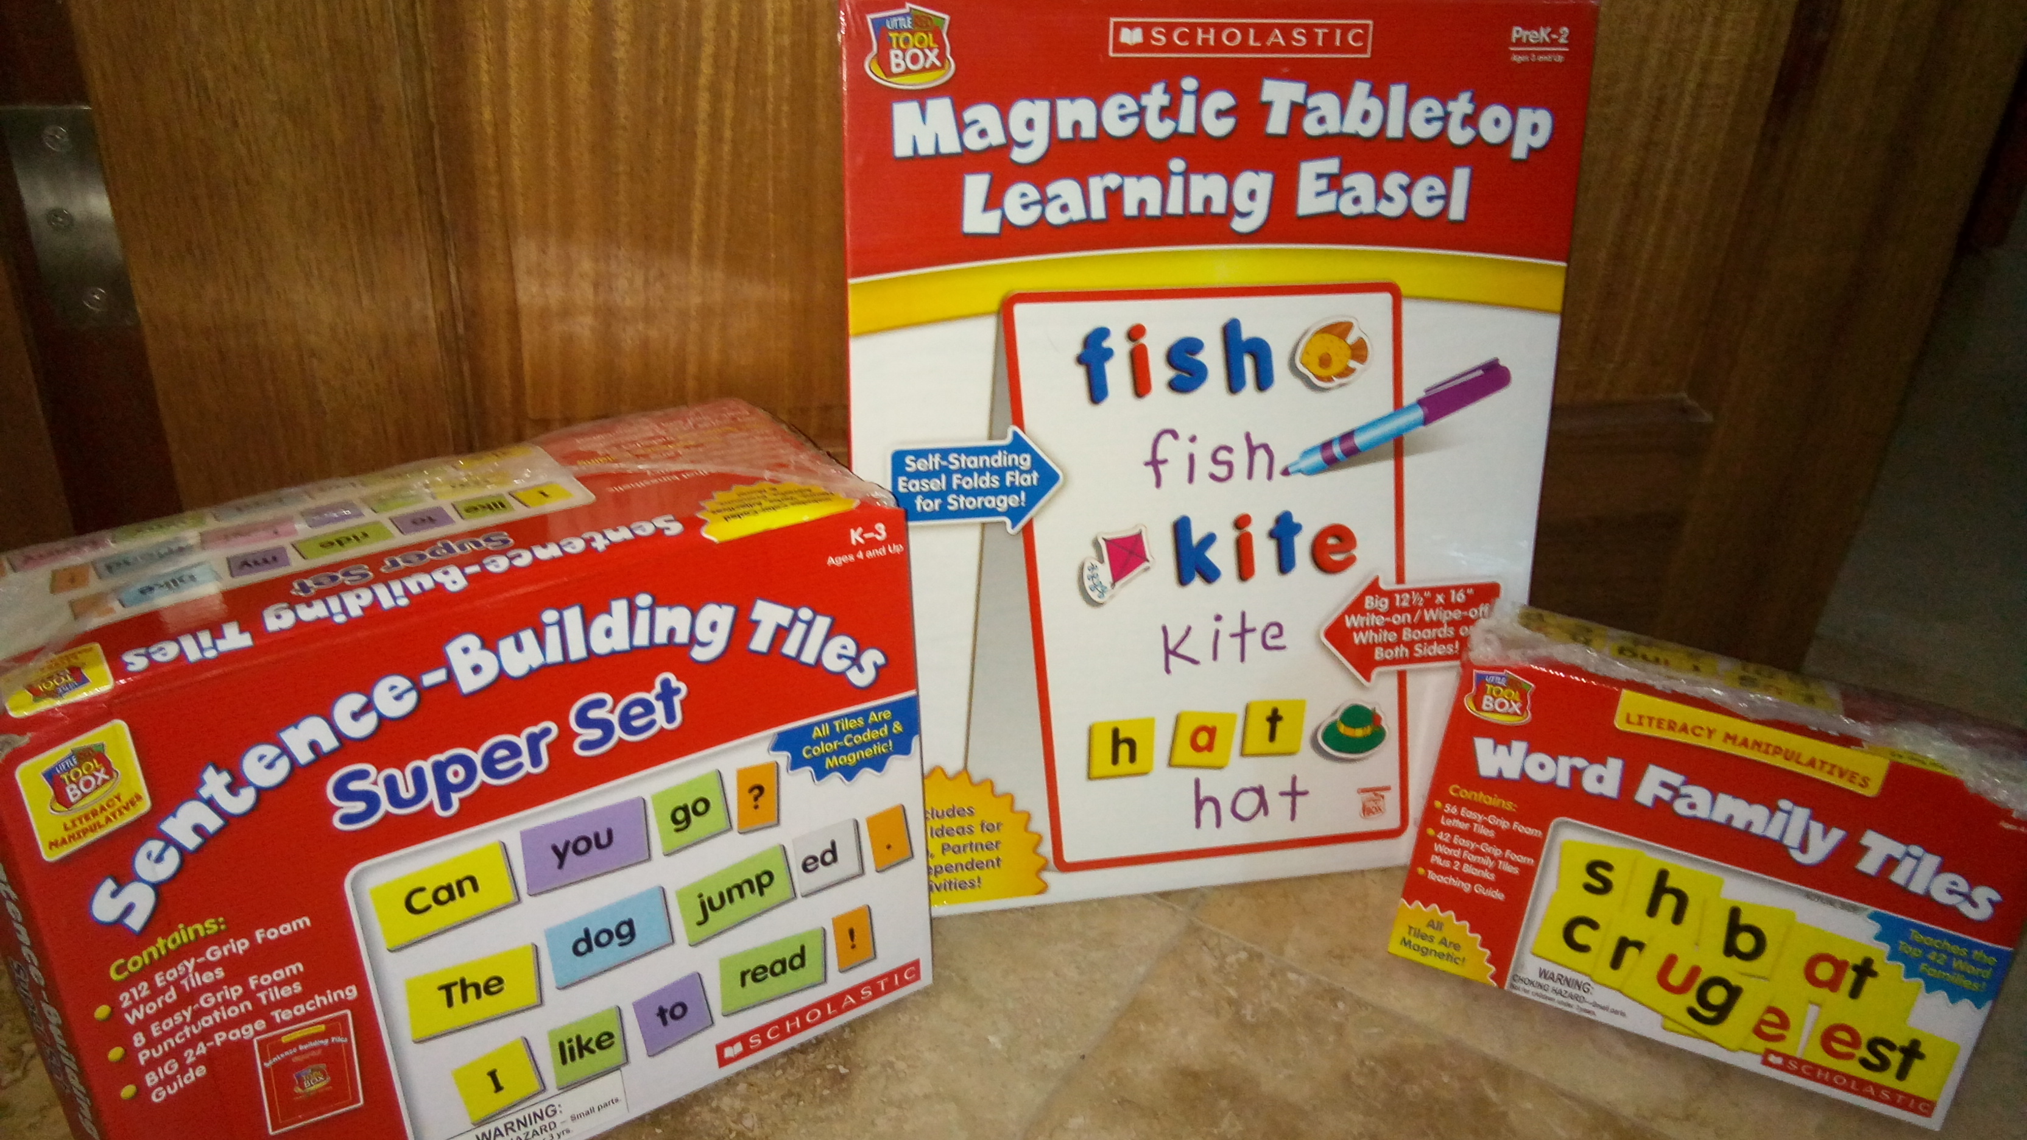
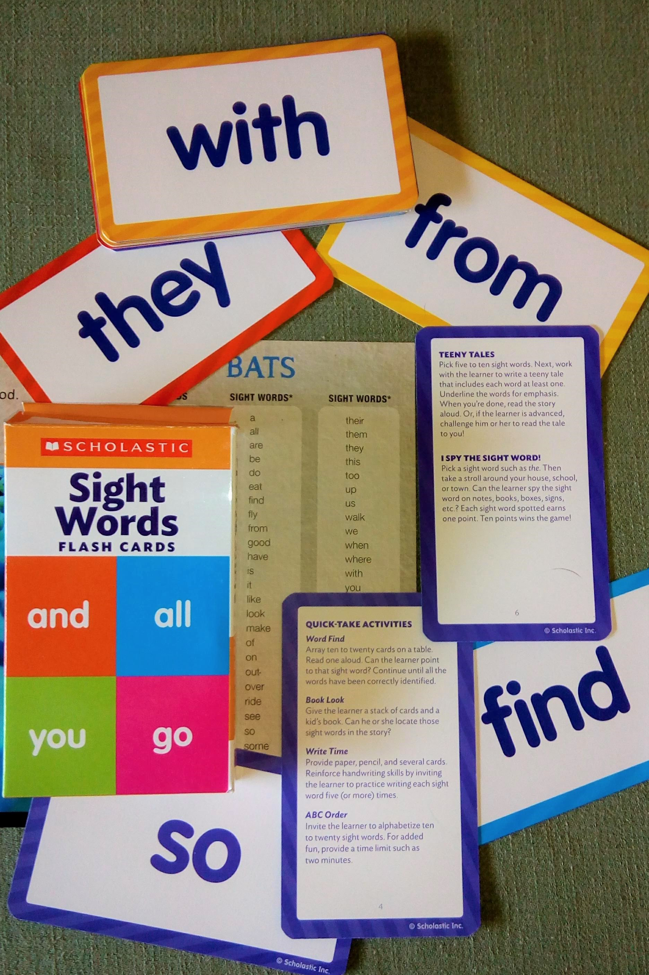
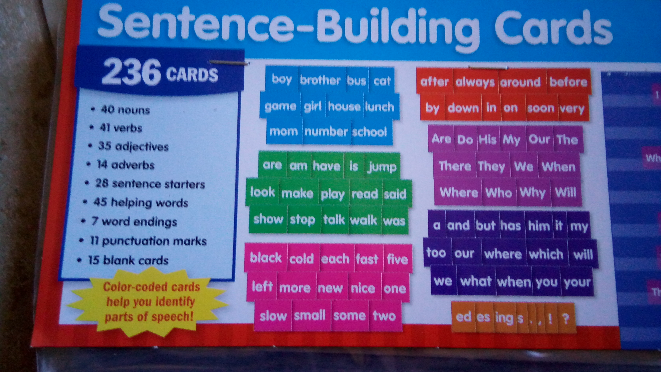
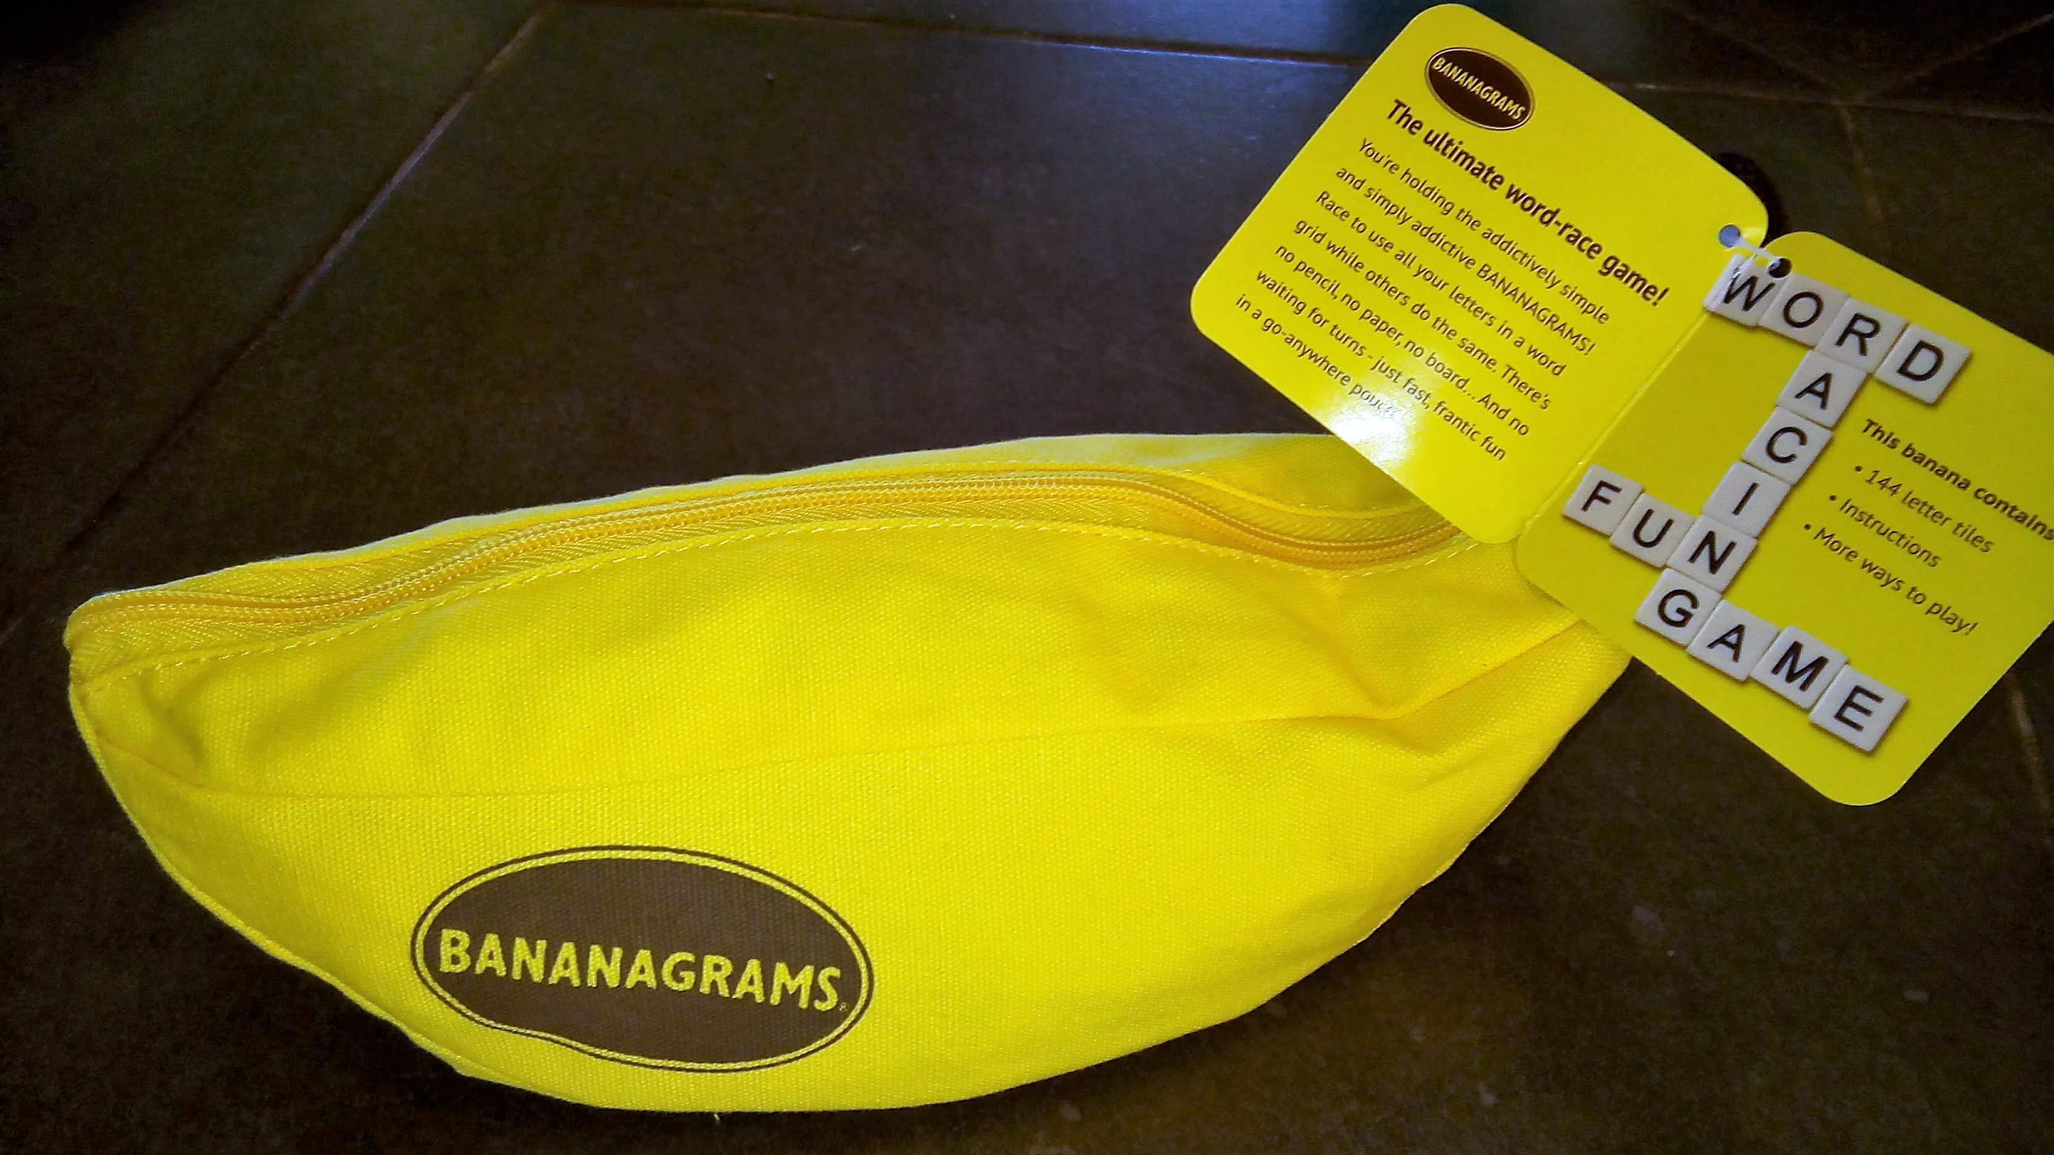
Group work
Prepare two or more phonics/vocabulary mini lessons or center ideas with the kit item you received to cover vocabulary, phonics or sight words in the Bats book.
You can choose to use ideas from the items list or you can choose to make your own.
Notes:
Have participants come up with a center ideas, game ideas or other that corresponds to something being taught in the BAT lesson plan to share with the group. Give them 20 minutes or so and then have them present their ideas.

Slide 25
Group Presentations

Slide 26
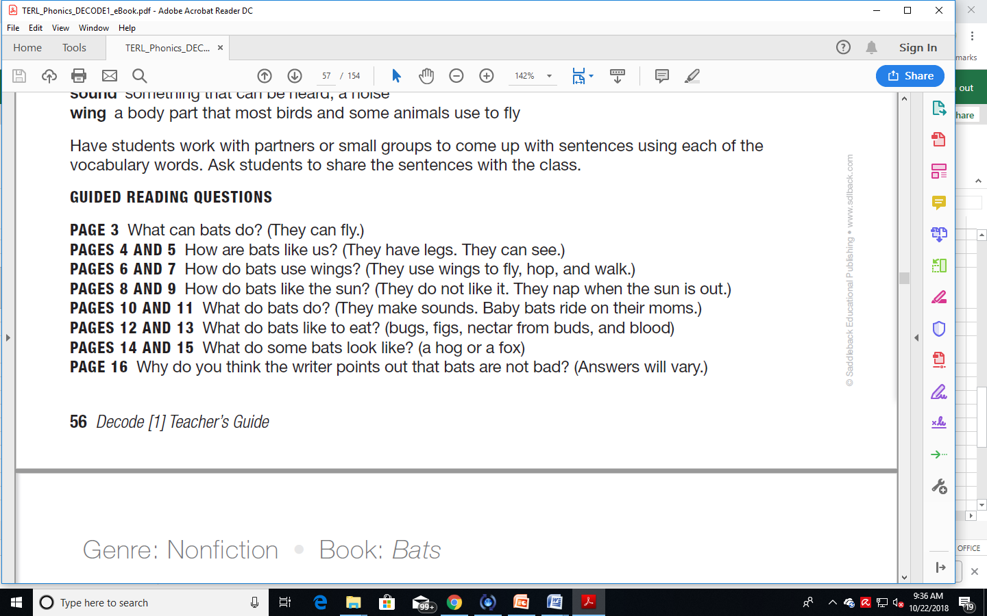
During reading
Guide students as they read, provide wait time, give prompts or clues as needed by individual students, such as "Try that again. Does that make sense? Look at how the word begins.“ You can also ask them to stop at points within the text and ask themselves questions about what they have read.
Notes:
Now that we know what to do before reading we will continue by going over during reading and after reading ideas based on the lesson plans provided in the decode system.

Slide 27
Read for Understanding
Have students read the text independently out loud. Why?
You can hear if they are struggling with any phonics and prompt them accordingly.
You can teach them to pause as they read and ask them the guided reading questions to check themselves for understanding.
Notes:
When you pause to ask the guided reading questions you are checking in with the students to see if they are understanding the text.

Slide 28
Read independently
Ultimate goal is to have students read a text at the same level of difficulty without you, independently.
Students read at different paces, so a “early finishers” activity will keep the faster readers working rather than waiting on slower readers.
Use the comprehension quiz at the end of each lesson plan to verify students have understood a text independently.
Notes:
What activities could you use to create an early finishers activity?

Slide 29
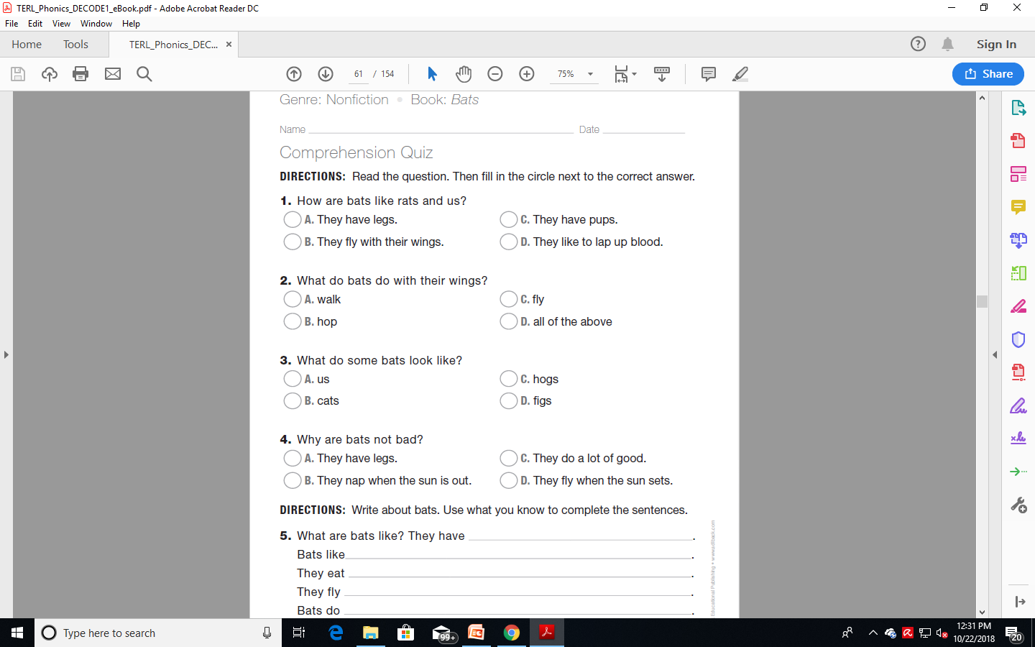
Comprehension Questions - Discussion
After students are finished, discuss the text and students’ responses.
As part of the discussion, ask students how they used the information from your introduction as they read.
Specific questions/and answers are provided at the bottom of each lesson plan in the Teacher’s Manual and there are comprehension quizzes provided.

Slide 30
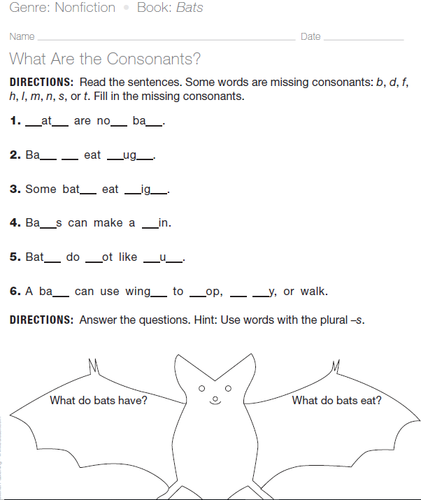
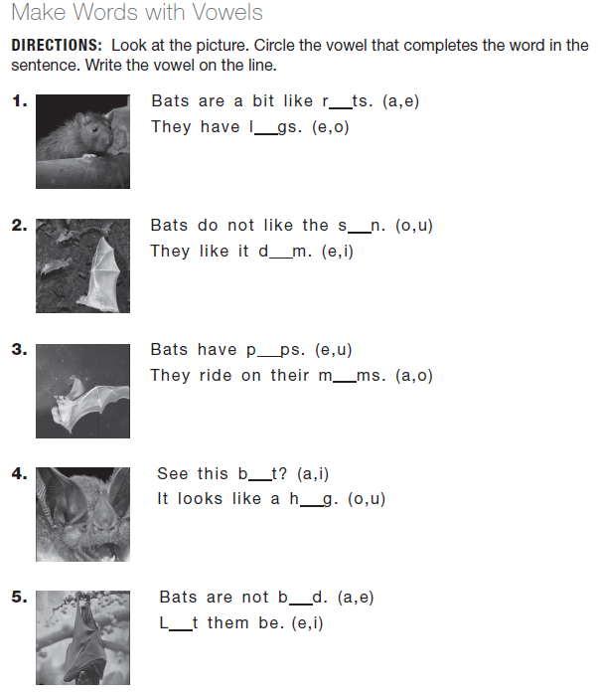
Progress checks
Notes:
You can choose to use the reproduceable activities provided at the end of each lesson plan to provide more practice for your students based on their needs.

Slide 31
Tracking your students progress
Book | Date Read | Guided Reading Questions Completed | Activity Sheet 1 Score | Activity Sheet 2 Score | Activity Sheet 3 Score | Quiz Score | Comments
Bog Man
Fads
Hip Hop
The Lab
Mad
The Mix
Bats
Fit
Notes:
Page 21

Slide 32
Exit Slip: For any Book
After students have read a book, provide them with an exit-slip prompt to help them reflect on their reading comprehension and also provide material for assessment and review. Possible prompts include:
What did you like best about this book?
What do you think will happen next?
What do you think the message of this book is?

Slide 33
Group Work
Pick a book from the decode set.
Become an expert on your book and lesson plan
Determine how you will teach the vocabulary and phonics in your book prior to reading.
Determine how you will use the remedial kit materials to enhance your students learning of the books content.
Prepare a 3 minute presentation about your book
Notes:
A good 30 to 40 minutes for teachers to read the book through, read the lesson plan through and to choose different kit items to enhance and expand on the lesson plan in the Decode manual was a good amount of time. You can give them more or less time depending on how much time you have left, just remember to allow for the presentation time and the wrap up conclusion of the workshop.

Slide 34
Group Presentations

Slide 35
Address Concerns
Not all books need to be used for the Decode system to be effective.
If you do not like some of the titles that have controversial content, do not use them.
Use the books that you like and that you feel comfortable with your students reading. There are many!
Notes:
Giving the information to others not in attendance. Share the power point presentation with attendees for reference and for them to share the training they received.

Slide 36
Wrap UP
Follow up survey to determine usefulness of the kits will be given to you to fill out at the end of term 2.
Notes:
You may need to change the timing of the survey follow up based on when you do the workshop.

